Slide 1
Securing the ADS-B Display System
Security Fighters | SEC Team 3
Notes:
Hi everyone,
I'm Hong from Security Team Three, Security Fighters.
I'll be giving today’s presentation.

Slide 2
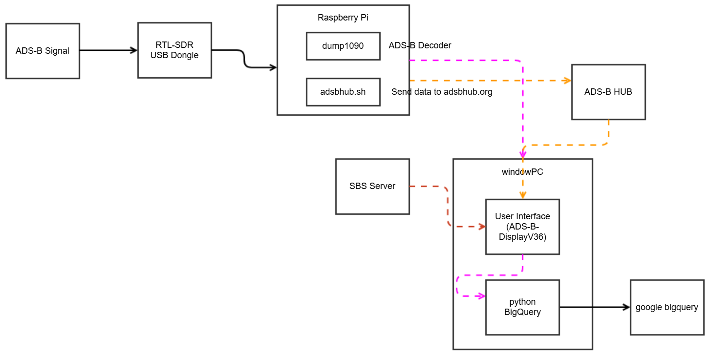
Flow Diagram
Notes:
Let me start with a quick overview of the system.
Since most of you are already familiar with it, I’ll keep this part brief.
ADS signals are received by a Raspberry Pi and sent to both a Windows PC and the ADS Hub.
The Windows PC runs a Python script that forwards SBS data to BigQuery.
It can also receive SBS data from the SBS server.

Slide 3

[C] Ensure the confidentiality of authentication credentials to retrieve flight information
[C] Provide encryption for sensitive data in transit
[I][A] Ensure integrity, authenticity, and timely availability of transmitted data
[C][I] Authenticate all external communication endpoints
[C] : Confidentiality, [I] Integrity, [A] Availability
Notes:
To define our security requirements, we followed the SQUARE process.
Our goals were centered on the classic CIA triad — Confidentiality, Integrity, and Availability.

Slide 4
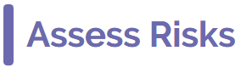
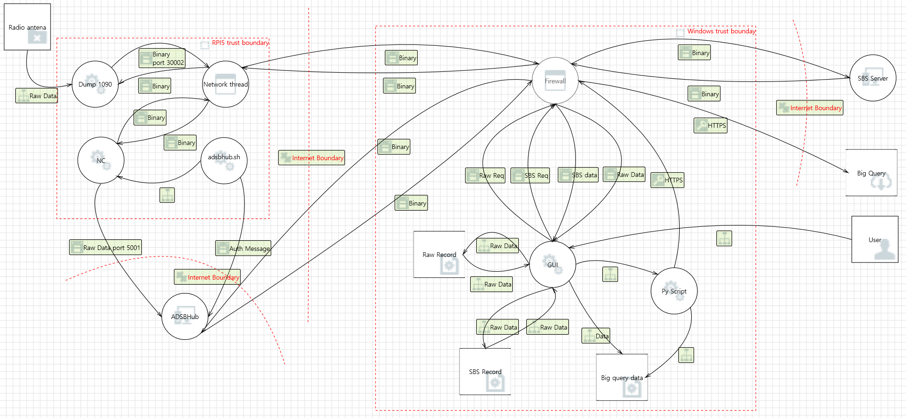
DFD
Notes:
For threat analysis, we used the STRIDE model to identify potential risks across the system.
Here’s how the system works in more detail:
Dump1090 receives the ADS signals and sends them to the Windows PC.
A shell script called adsbhub authenticates with the ADS-B Hub, and uses netcat to forward the data.
The Windows PC also has a firewall that allows the GUI to access this data, which is stored as raw records, SBS records and bigQuery data.
In additional, bigQuery data is sent to Google BigQuery by another Python script.
The GUI is also directly accessible to users.
Based on this analysis, we identified a total of 136 threats, with 21 considered high priority.

Slide 5
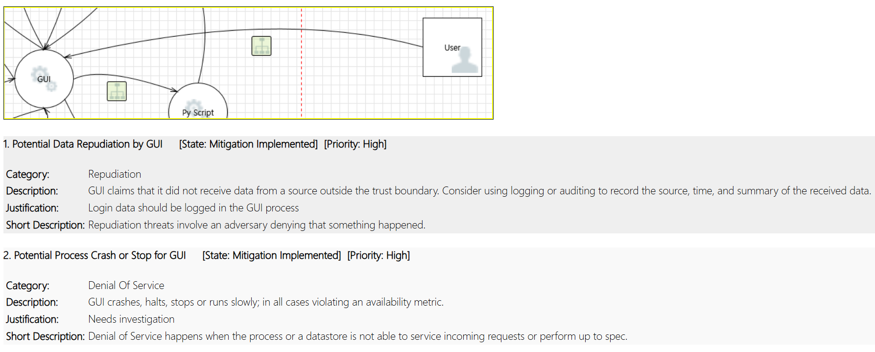
GUI <-> User
Notes:
The following interactions involved a high number of high-priority risks:
The interaction between the GUI and the user falls under the categories of Repudiation and Denial of Service.

Slide 6
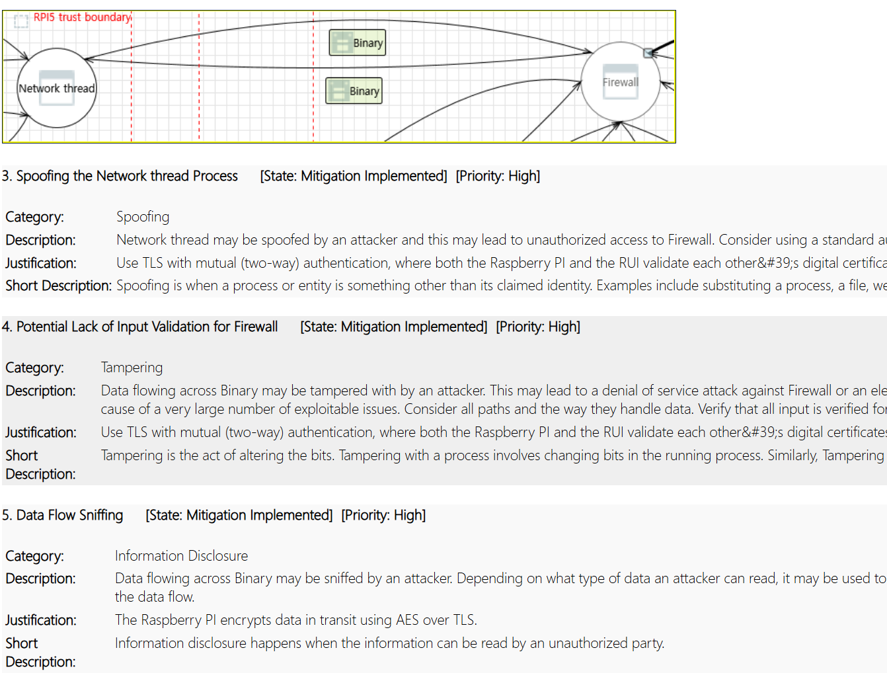
RPI5 <-> Windows Firewall
Notes:
The interaction between the Raspberry Pi and the Windows PC falls under the categories of Spoofing ,Tampering and Information Disclosure.

Slide 7
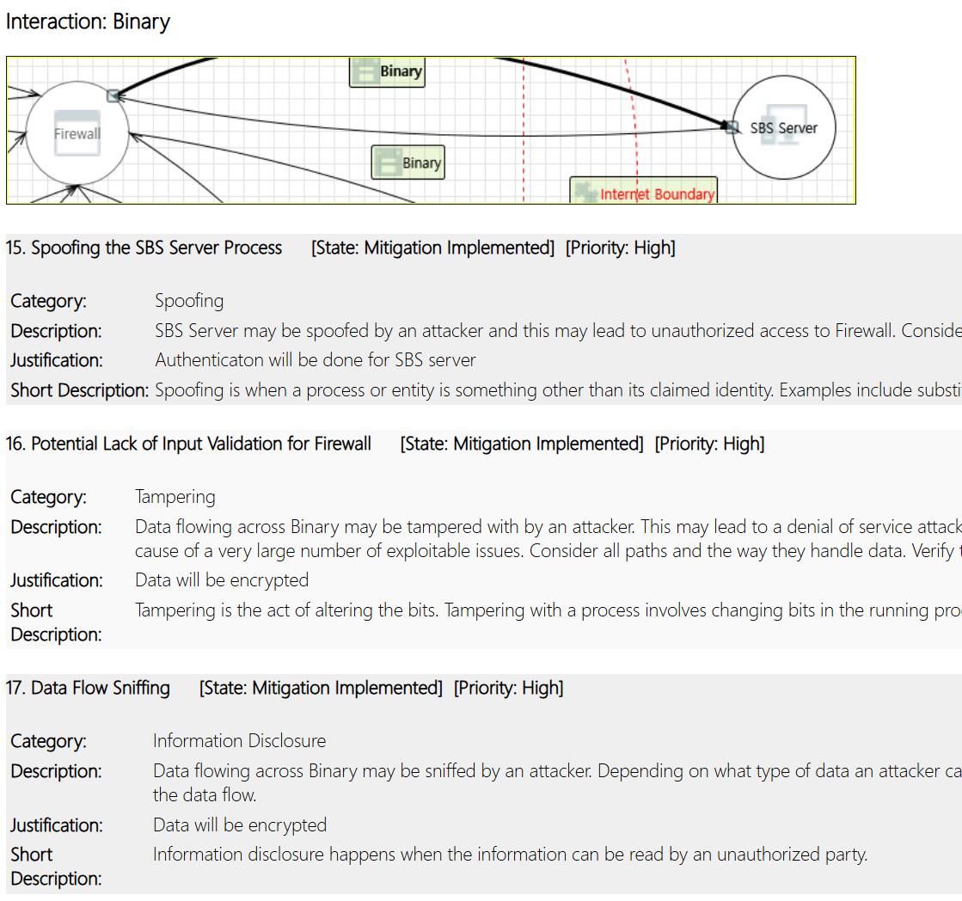
Windows Firewall <-> SBS Server
Notes:
The interaction between Windows and the SBS server falls under the categories of Spoofing ,Tampering and Information Disclosure.

Slide 8
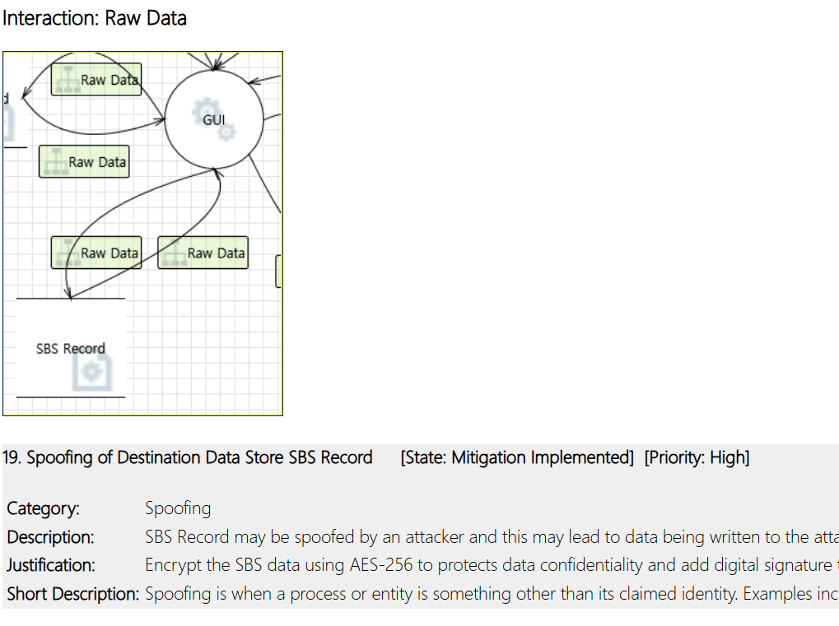
GUI <-> Record (RAW, SBS)
Notes:
The data path from the GUI to stored records falls under the categories of Spoofing

Slide 9
Threat | Impact | Mitigation | Severity | Likelihood | Priority
Login data interception | Credential leakage | Passwd Policy and PBKDF2 alogrithm | 5 | 4 | 5
Fake Raspberry PI impersonation | Data manipulation | TLS Encription | 5 | 3 | 4
Data tampering in transit | Loss of integrity | HMAC-SHA256 | 4 | 3 | 4
Unauthorized SBS access | Backend compromise | Enforced authentication | 4 | 2 | 3
Unauthorized access to locally stored GUI records | Leakage of sensitive data stored on the device | Encrypt data records at the point of storage within the GUI to ensure confidentiality | 4 | 3 | 4
1: very low 2: low 3: medium 4: high 5: very high
Notes:
To address these, we created a mitigation plan.
We documented possible solutions and assigned priorities based on impact and feasibility.
It wasn’t easy — every threats were just as important as others.

Slide 10
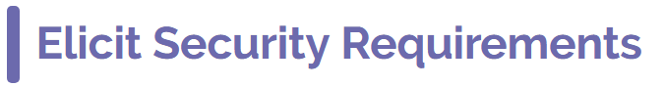
Req. ID | Security Attribute | Requirement Description | Priority
SR-001 | Authentication | Raspberry PI and RUI must use TLS. | HIGH
SR-002 | Confidentiality | Record data must be encrypted with AES-128 during transmission to protect confidentiality. | HIGH
SR-003 | Integrity & Authenticity | Stored data must be protected using HMAC-SHA256 with a secret key. The application must verify integrity by comparing the stored HMAC with a newly computed value before use. | MEDIUM
SR-004 | Confidentiality | Symmetric encryption keys shall be securely stored in a protected area. | HIGH
SR-005 | Authentication | Authentication must be performed for all interactions with the SBS server. | HIGH
SR-006 | Confidentiality | The password must be protected using PBKDF2 with the SHA-256 hash function. The salt must be securely stored in a trusted storage location, and the iteration count must be 10,000 or more. | HIGH
Notes:
From this work, we ended up with several key security requirements.
These included using TLS between the Raspberry Pi and the user interface,
encrypting recorded data with AES-128,
protecting stored data with HMAC-SHA256,
storing encryption keys securely,
and using PBKDF2 for password protection.

Slide 11
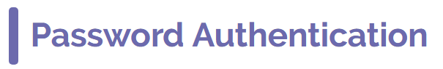
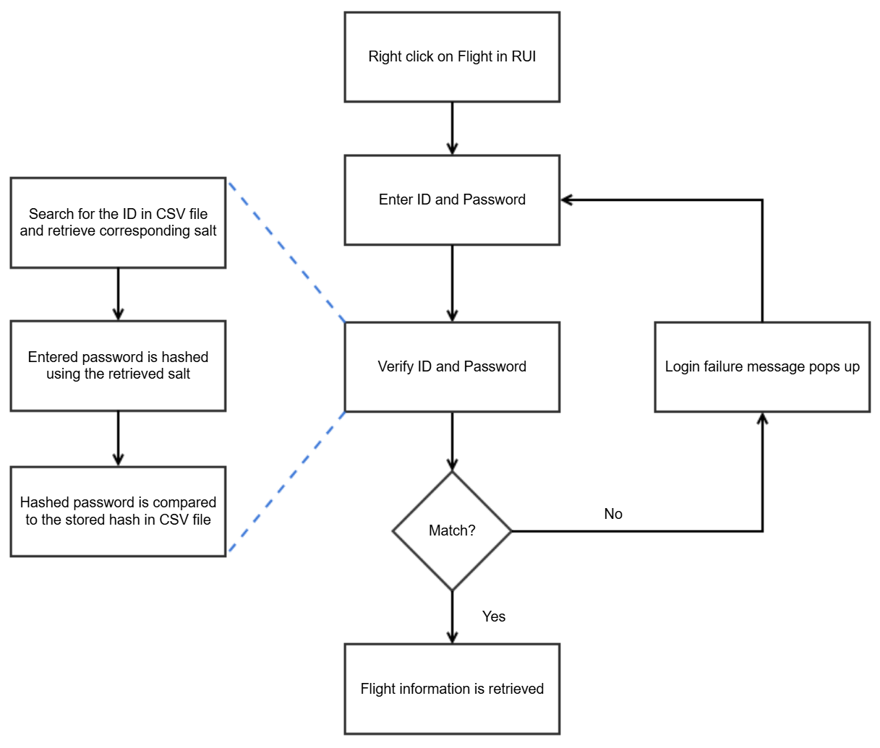
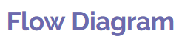
Notes:
Now let me show you the changes we made based on those requirements. First, we improved the login authentication process.
When users right-click on a flight item, they’re prompted to enter their ID and password.
The system uses a stored salt to hash the password with PBKDF2 and compares it to the saved hash.

Slide 12

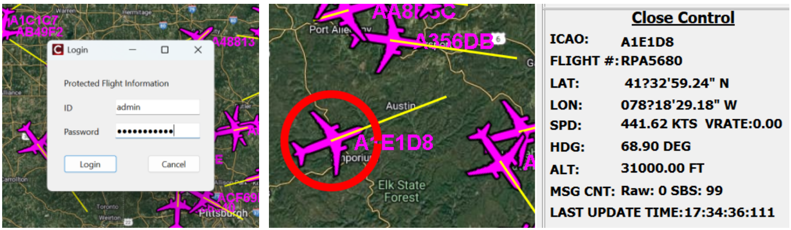
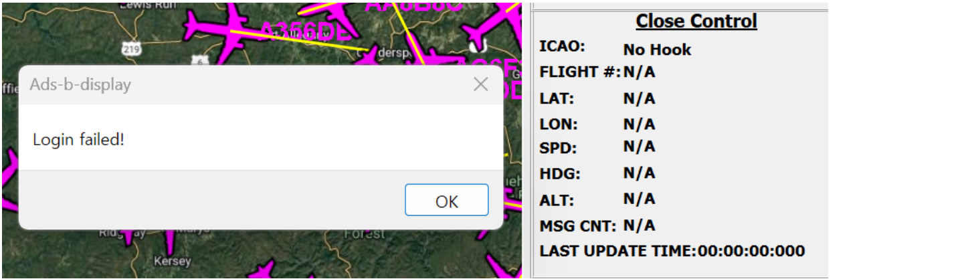
- When login is successful, flight information is retrieved.
- When login failed, Login failure message pops up and flight information is not retrieved.
Notes:
If the authentication succeeds, the flight data becomes visible — otherwise, access is denied.

Slide 13
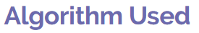
PBKDF2
Brute-force resistant
Salted hashing
Slow by design
Notes:
PBKDF2 makes brute-force attacks much harder by intentionally slowing down the password hashing process. It does this by applying a hash function ten thousands of times, which means an attacker has to spend a lot more time to guess each password. Also, the use of a unique salt for each password ensures that even if two users have the same password, their hashed values are completely different. This prevents precomputed attacks like rainbow tables from being effective.

Slide 14
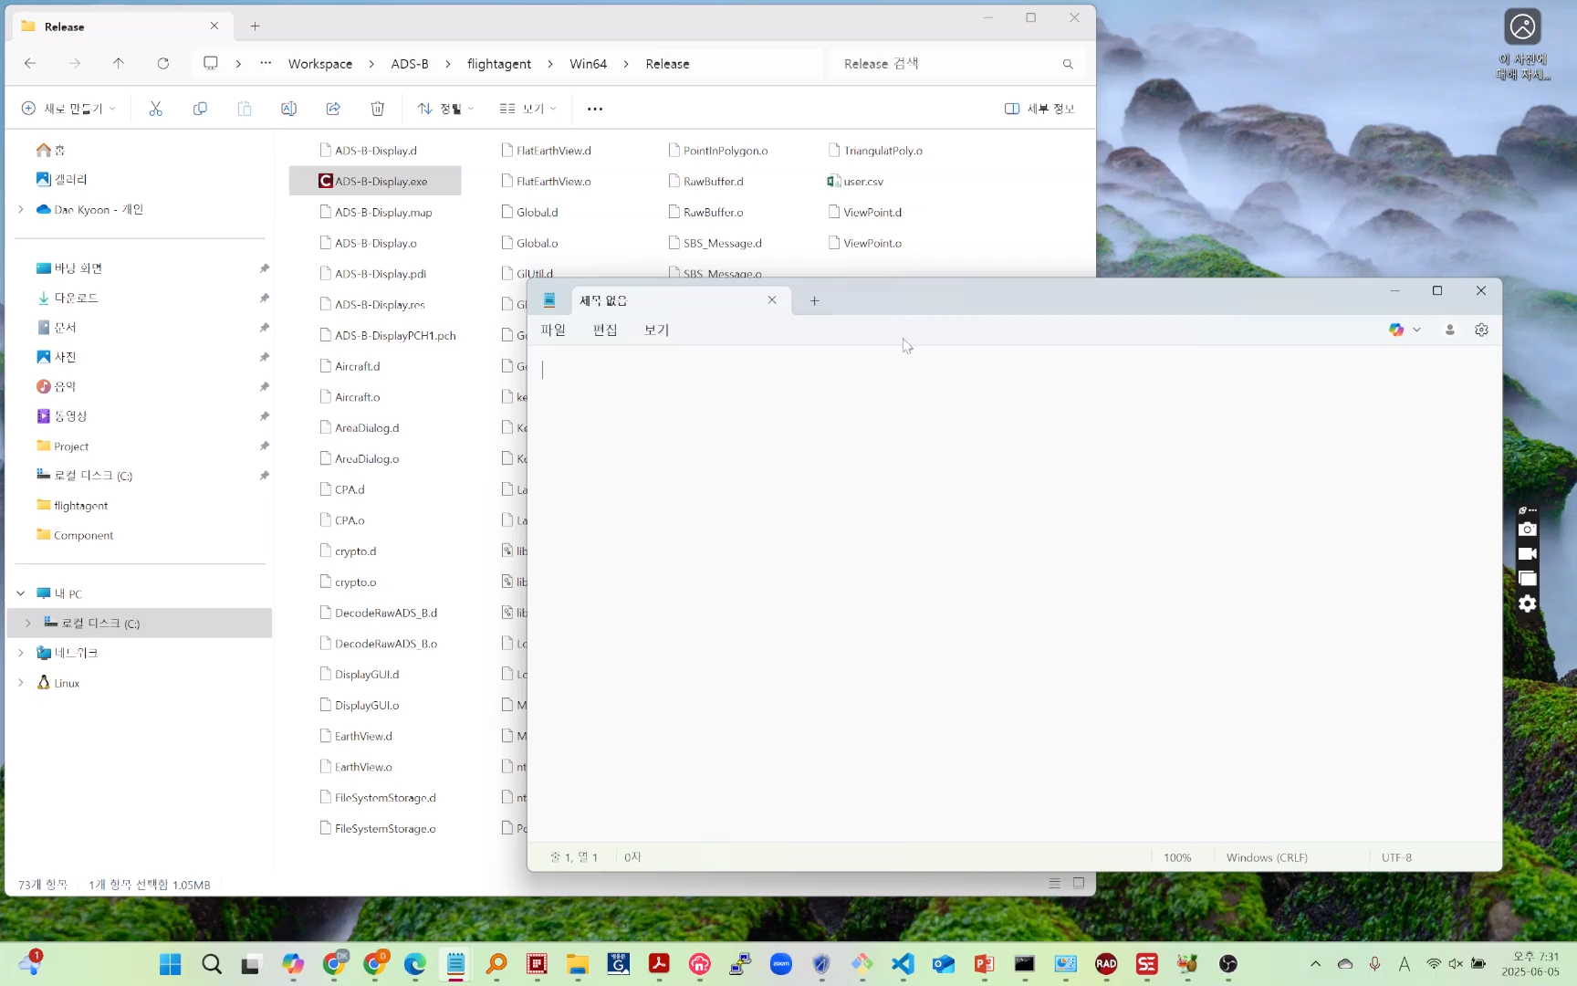
Notes:
Lets see the demo video.

Slide 15
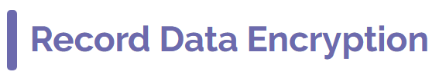
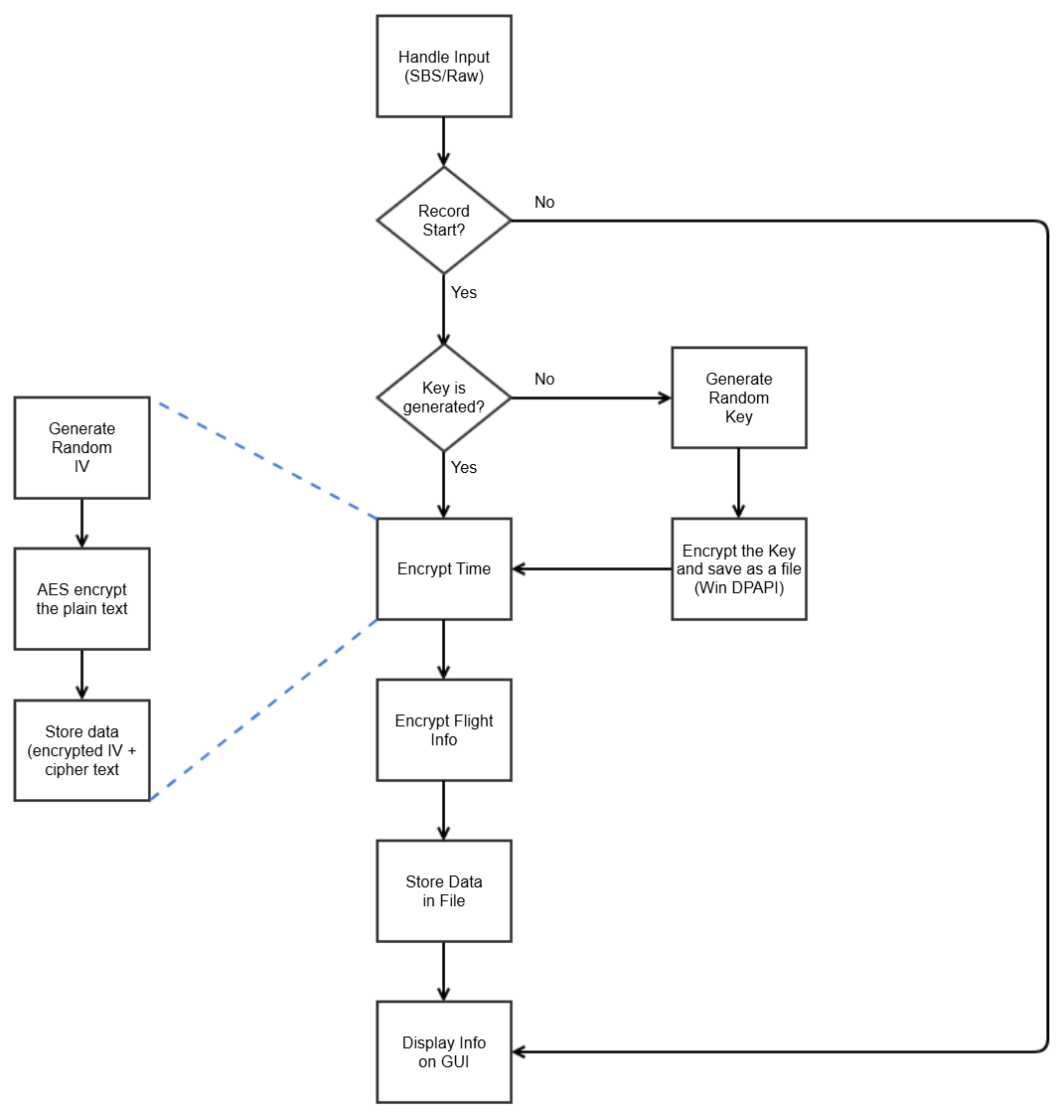
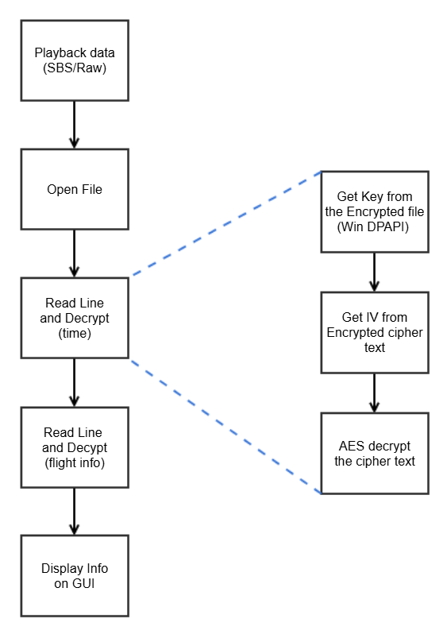
Encryption
Decryption
Notes:
We also worked on encrypting the recorded data.
When recording begins, the system checks for an existing key.
If there isn’t one, it securely generates a new key using Windows DPAPI.
The data is then encrypted using AES-128 with an initial vector.

Slide 16
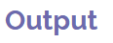
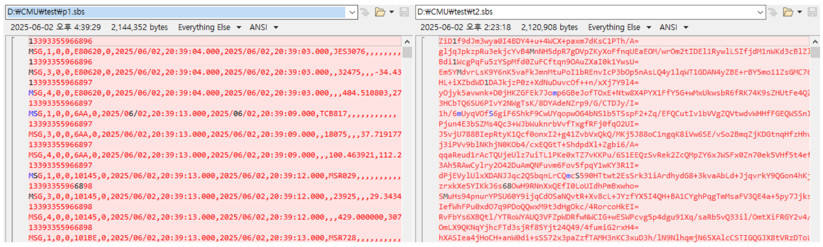
: Left side(p1.sbs) is not encrypted data. Data might be disclosed to other users.
And right side(t2.sbs) is encrypted data with AES algorithm. Each line of cipher test contains IV data and flight info.
Notes:
On the left, you can see the plain record — the original readable data. On the right, the same data has been encrypted using AES-128, making it unreadable without the proper key.

Slide 17
AES-128 (CBC)
DPAPI
AES-128 Strong encryption Widely used Fast
DPAPI
Built-in protection
User-bound encryption
Notes:
We used AES-128 to encrypt the record data. AES-128 is a widely trusted encryption algorithm known for its balance of strong security and high performance. To keep the encryption key safe, we used Windows DPAPI. DPAPI securely stores the key by binding it to the user or system, which makes it difficult for attackers to retrieve the key even if they gain access to the device.

Slide 18
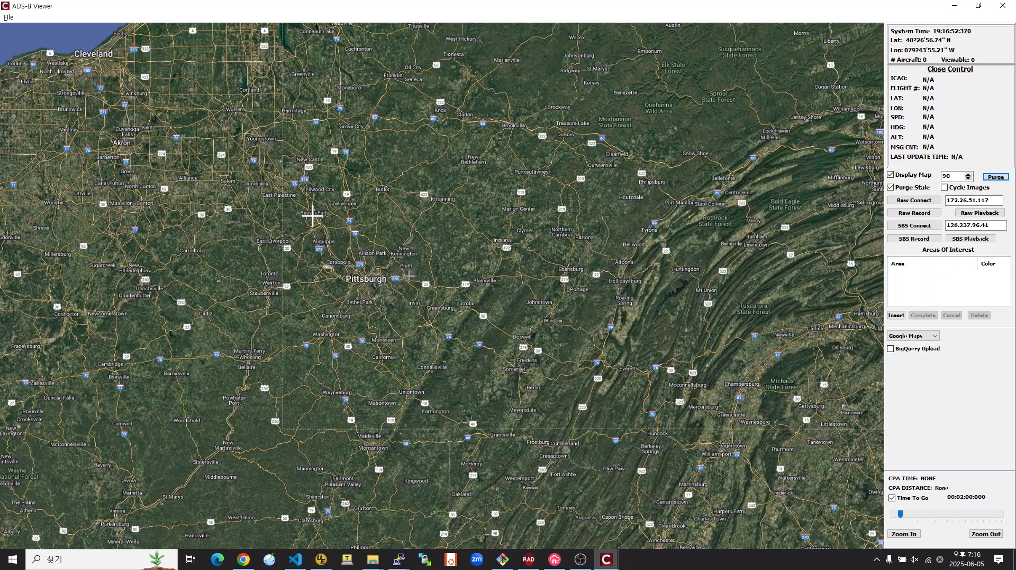
Notes:
Let’s see the demo video

Slide 19
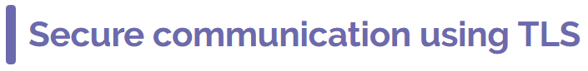
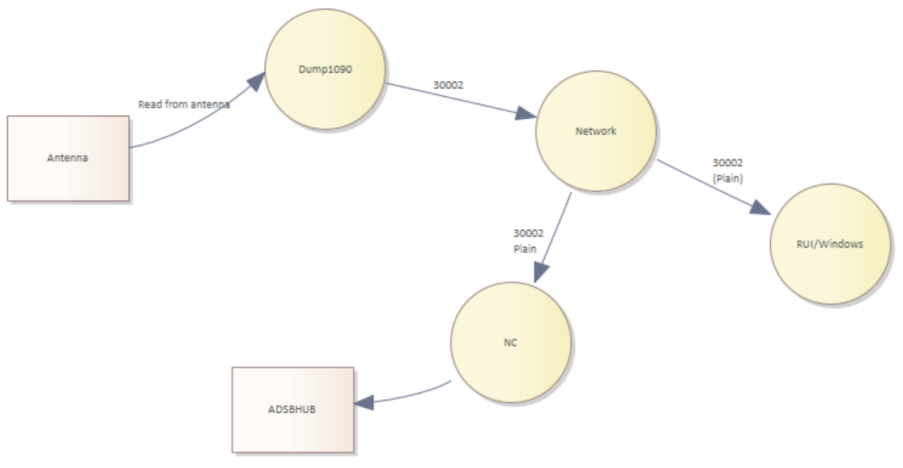
Before
Notes:
Next, I will talk about the implementation of TLS.
In the current setup, the Raspberry Pi uses port 30002 to communicate simultaneously with both the Windows PC and the ADS-B hub.

Slide 20
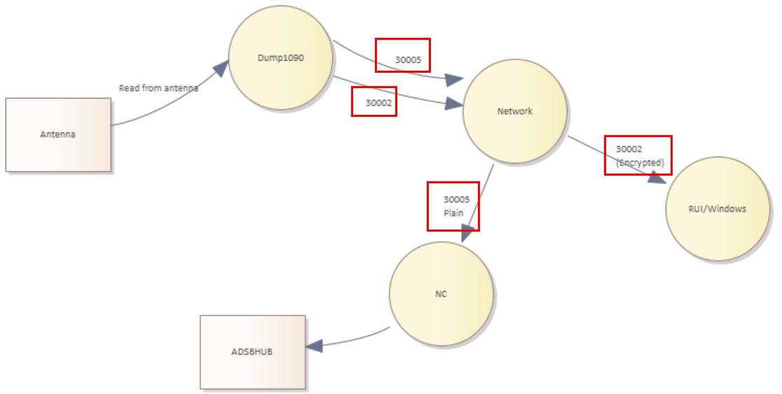
After
Notes:
To apply TLS, we used port 30002 for encrypted data and added port 30005 for forwarding data to the ADS-B Hub in plain text.

Slide 21
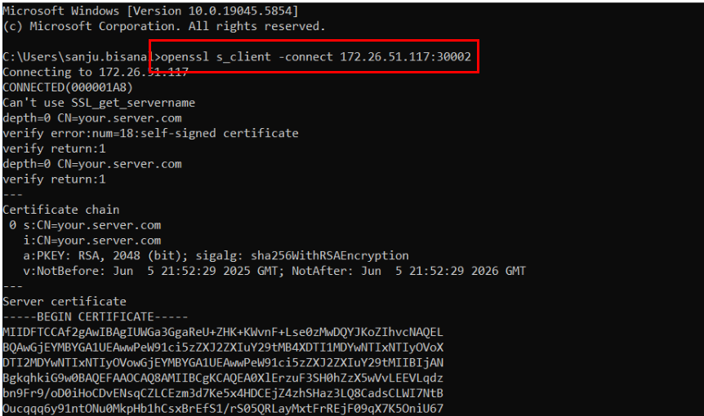
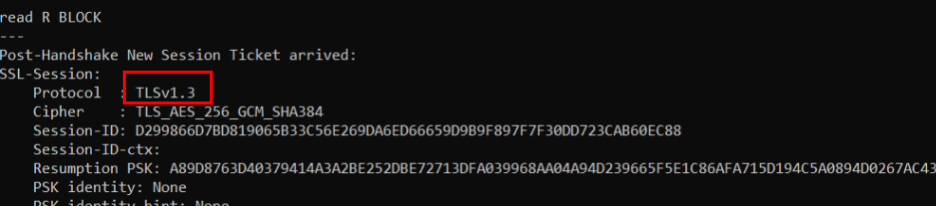
Notes:
As shown in the captured image, port 30002 on the Raspberry Pi is confirmed to be using TLS 1.3.
By using TLS, the data sent from the Raspberry Pi to the Windows PC is encrypted.
This means that even if someone captures the data on the network, they won’t be able to read it.

Slide 22
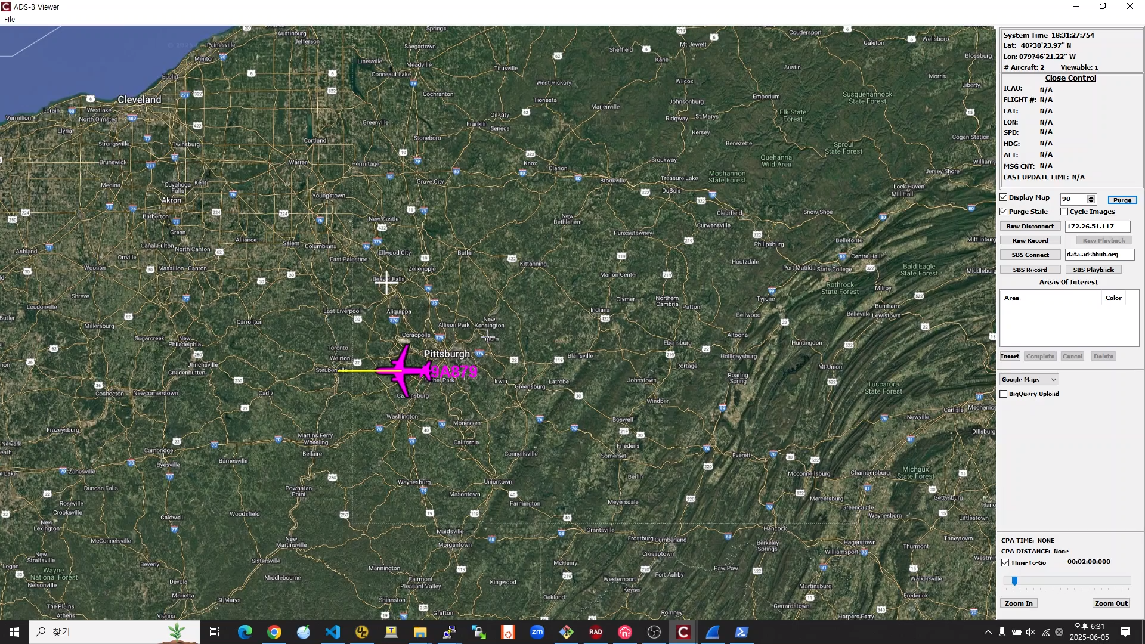
After
Notes:
Let’s see the demo video.

Slide 23

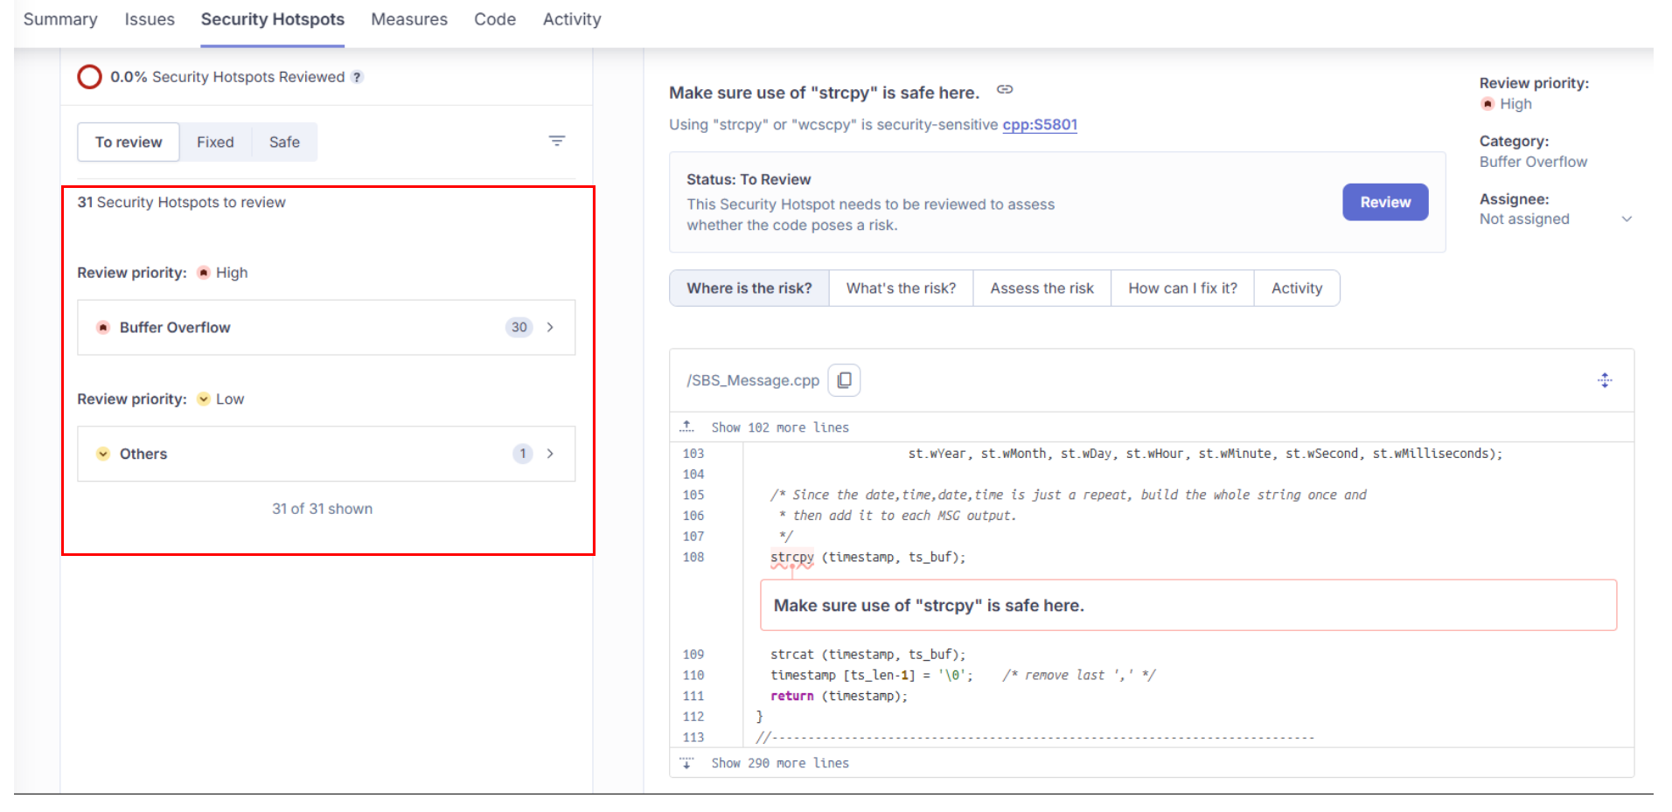
SonarQube results before modification
Notes:
To make sure our code was secure, we ran a static analysis with SonarQube.
We found 31 security hotspots.

Slide 24
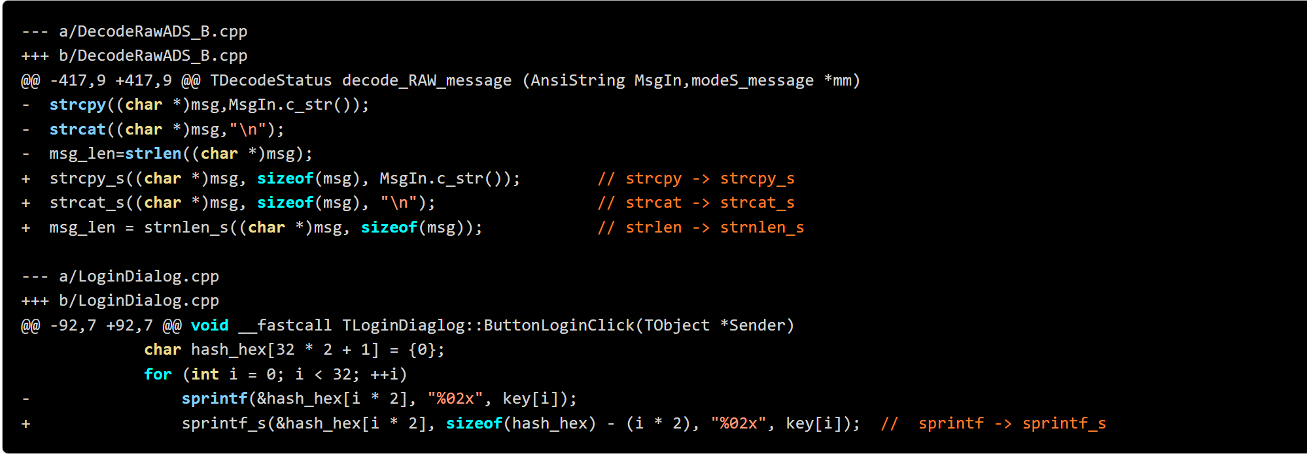
- Replaced unsafe functions strcpy with strcpy_s - Replaced unsafe functions strcat with strcat_s - Replaced unsafe functions sprintf with sprintf_s - Replaced unsafe functions strlen with strnlen
- Examples we changed the Security Hotspot issues
Notes:
We were able to fix 30 of them, including some functions that were not safe to use.

Slide 25
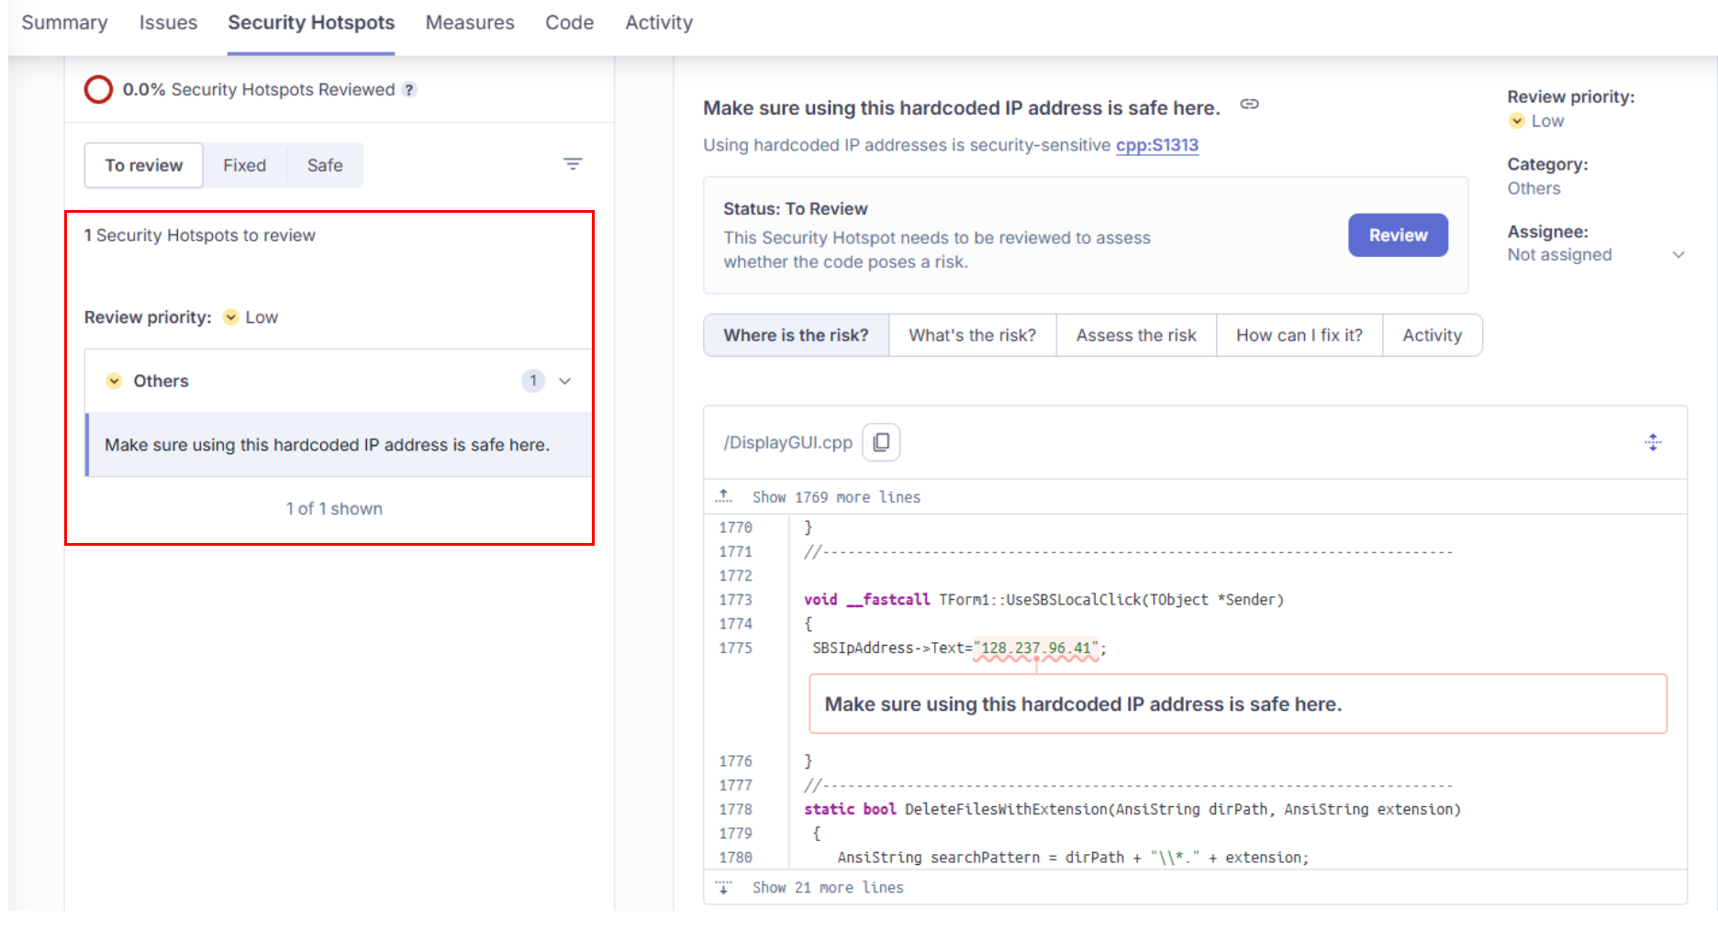
SonarQube results after modification
Notes:
There’s still one issue left — a hard-coded IP address — but we considered it low priority.

Slide 26
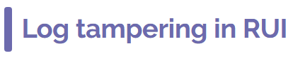
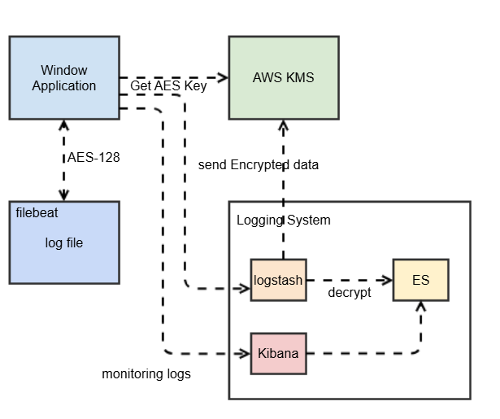
Notes:
While discussing other risks, we also identified some that weren’t covered by STRIDE.
One example is the lack of non-repudiation in application logs.
To tackle that, we suggested encrypting the logs and using the ELK stack for secure log management.

Slide 27
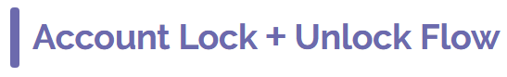
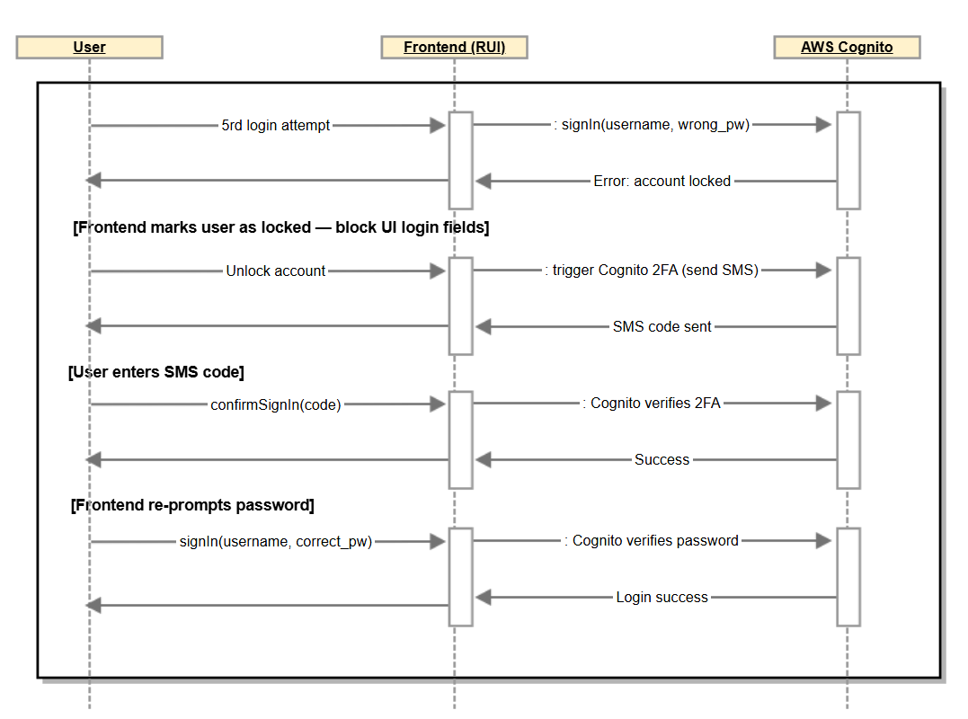
Notes:
We also looked into two-factor authentication.
We identified it as a security risk, but we haven’t implemented any fixes yet.
To tackle that, we suggested exploring the use of AWS Cognito for handling account lockouts and enabling two-factor authentication after repeated PIN failures.

Slide 28
Identified. Secured. Ready
Notes:
So in conclusion, using the SQUARE and STRIDE models really helped us identify and refine our security goals.
It was a valuable process that gave us clearer direction.
Although we couldn’t fully resolve issues with the SBS server path and data integrity, we believe we’ve built a strong foundation for future improvements.

Slide 29
Q & A
Notes:
So in conclusion, using the SQUARE and STRIDE models really helped us identify and refine our security goals.
It was a valuable process that gave us clearer direction.
Although we couldn’t fully resolve issues with the SBS server path and data integrity, we believe we’ve built a strong foundation for future improvements.

